Slide 1





TransitWallet
Pitch Deck
Edna Wanjiku

Slide 2


Purpose
Statement
Transit Wallet: Is dedicated to revolutionizing the public transportation payment experience by offering a secure, convenient, and versatile platform for managing transport payments. The app supports both online and offline transactions, ensuring seamless payment processes through mobile payment gateways and USSD codes. By providing real-time account updates and a user-friendly interface, Transit Wallet aims to enhance the efficiency and accessibility of public transport systems, fostering a more connected and convenient commuting experience.

Slide 3





The Problem
Inconvenient Payment Methods:
Lack of Real-Time Account Management:
Security Concerns

Slide 4


The Solution
Transit Wallet revolutionizes payment solutions with a seamless mobile app. The app's real-time management ensures instant notifications, balances, and transaction histories, empowering users with transparent expense tracking. With advanced encryption, Transit Wallet guarantees a safe and fraud-free transaction environment.

Slide 5






Why Now?
Salford & Co
01
02
03
Connectivity Challenges: Despite technological advancements, access to stable internet connectivity remains a challenge in many regions. Introducing offline payment options addresses this issue, ensuring inclusivity and accessibility for all users, regardless of their internet connection status.
Without the right data at the right time, small business operators are essentially flying blind
Growing Digital Dependency: With increasing reliance on digital transactions for everyday needs, there's a pressing demand for versatile payment solutions that cater to diverse user preferences and situations.

Slide 6
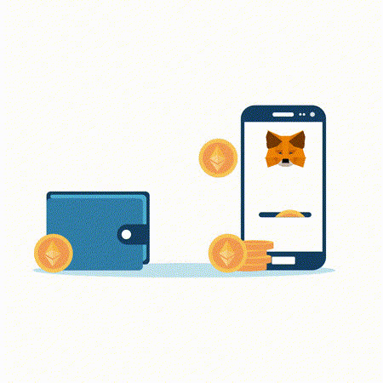
MVP
The MVP will offer a multi-channel payment system supporting digital wallets, cards, and mobile gateways, alongside an offline USSD payment feature for users without internet access. It will also provide real-time account management with transaction alerts, balance updates, and detailed transaction history, ensuring efficient expense tracking for users.
03
/10

Slide 7
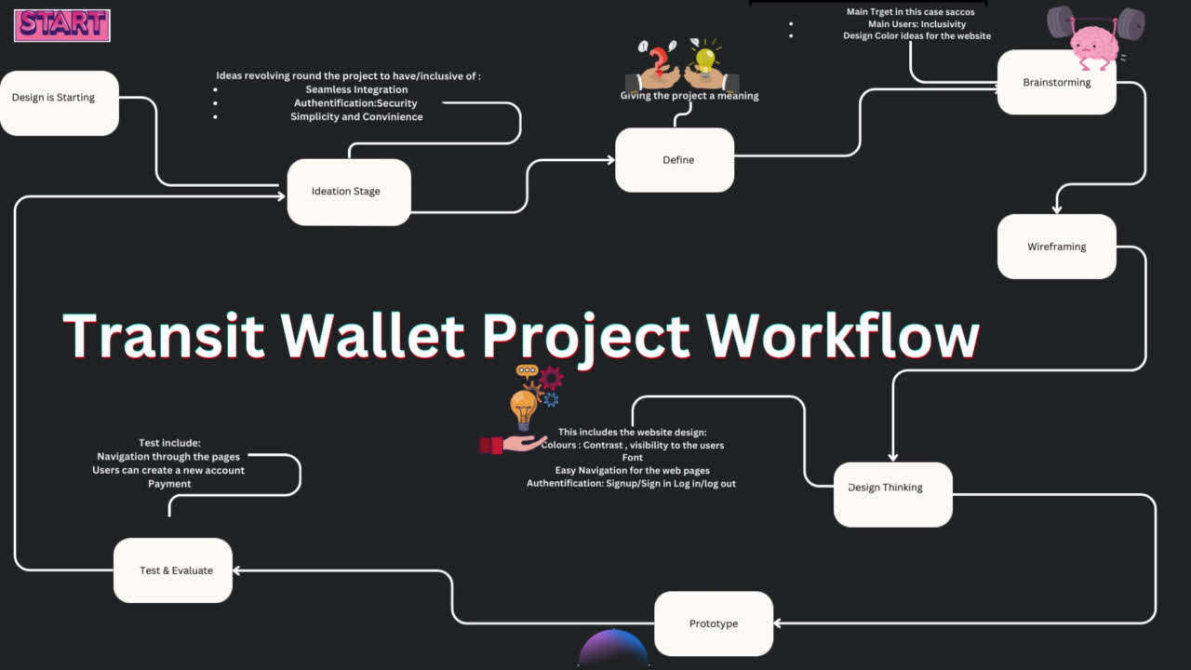
DEVELOPMENT

Slide 8

DEMO
/10

Slide 9






TECHNOLOGIES USED
Firebase
Python
Dart
Flutter
Postman

Slide 10
CHALLENGES
Integration Complexity: Integrating multiple payment channels (digital wallets, cards, mobile gateways) and ensuring seamless communication between them poses a significant technical challenge.
USSD Implementation: Implementing offline USSD payments requires coordination with telecom providers and adherence to specific protocols, adding complexity to the development process.
Real-Time Updates: Ensuring real-time account management features, such as transaction alerts and balance updates, demands robust backend infrastructure and efficient data processing mechanisms.
08
/10

Slide 11

ONGOING PLANS
Continuous Improvement: Continuously enhancing the UI for a better user experience and seamless integration with new payment methods and features.
Data Encryption: Implementing robust encryption protocols and security measures to safeguard user payment information and ensure compliance with data protection regulations.
Regular Testing: Conducting thorough testing, including unit tests, integration tests, and security audits, to identify and address any vulnerabilities before launching the application.

Slide 12
IN HOPE FOR :
Comprehensive Testing: Ensuring thorough testing across all aspects of the application, including functionality, security, and user experience, to guarantee a stable and reliable product.
User Feedback Integration: Incorporating user feedback during the testing phase to address any usability issues and refine the application further.
Successful Launch: Deploying the application to the app stores and promoting it effectively to attract users, aiming for a successful launch with positive user reception and adoption.

Slide 13

Q& A

